Slide 1
Machine learning
Regent College London
SWE6204

Slide 2
Machine learning
SWE6204

Slide 3

Machine learning
POLYNOMIAL REGRESSION

Slide 4
Module 1 – polynomial regression

Slide 5
Learning objectives
Understand concept of Polynomial Regression
Understand the Overfitting
Understand techniques to overcome Overfitting

Slide 6
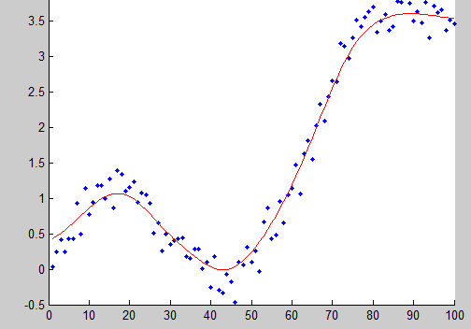
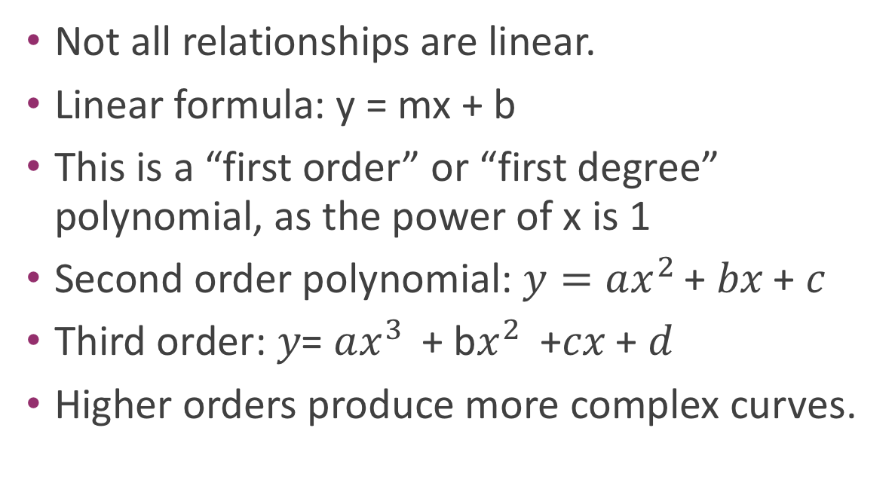
Why limit ourself to straight line
Not all relationships are linear.
Linear formula: y = mx + b
This is a “first order” or “first degree” polynomial, as the power of x is 1
Second order polynomial: $y=ax^{2 }$+ 𝑏𝑥 + 𝑐
Third order: 𝑦= $ax^{3 }$+ b$x^{2 }$ +𝑐𝑥 + 𝑑
Higher orders produce more complex curves.

Slide 7
Beware of overfitting
Don’t use more degrees than you need
Visualize your data first to see how complex of a curve there might really be
Visualize the fit – is your curve going out of its way to accommodate outliers?
A high r-squared simply means your curve fits your training data well; but it may not be a good predictor.
Later we’ll talk about more principled ways to detect overfitting (train/test)

Slide 8
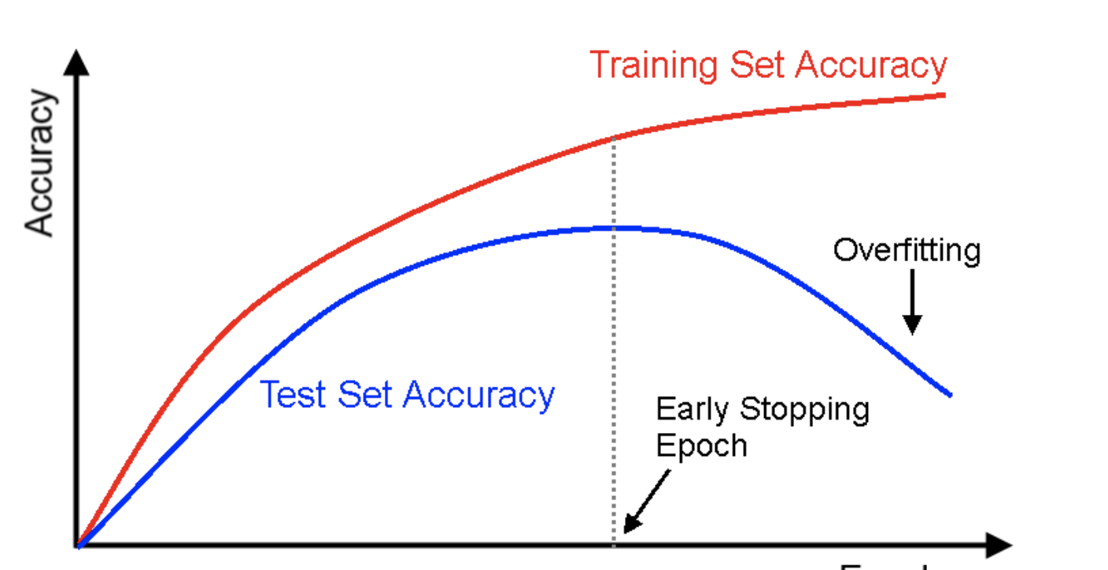
Overfitting

Slide 9
Python coding
Let’s play with an example
• numpy.polyfit() makes it easy.

Slide 10
+44 (0)207 016 8000
info@rcl.ac.uk

